Slide 1
Job Salary Analysis
in the UK
Chen Zhao
Jingyang Li
Pingchun Chiang
Shawn Winston

Slide 2
Attributes of Location & Category
Overview
Analysis of Data
Conclusion

Slide 3
1
Overview

Slide 4

Overview
● Salary data is useful to know when applying for jobs
● Helps prospective students decide which field to go into
● Depends on many factors
○ Location
○ Company
○ Job Category...

Slide 5
Objective
● Analyze salary data from the UK
● Determine which companies, job categories, and locations
are the most prevalent
● Find how those attributes affect overall salary

Slide 6
Dataset
● Dataset from Kaggle where the goal of the competition was to predict job salaries from job ads
○ Attributes in dataset that we looked at were:
Job Title, Location, Company, Job Category
○ Around 240,000 data entries
○ 20,813 unique companies
○ 29 job categories
○ 2732 unique locations

Slide 7
2
Analysis of Data

Slide 8
Dataset Statistics (Overall)
Energy, Oil and Gas Job - €45,653
Highest average paying job category
Global Medics Locums - €164,800
Highest average paying company
Highest average paying location
Quebec - €90,000
Overall salary
Average - €34,122
Max - €200,000 - Finance job

Slide 9
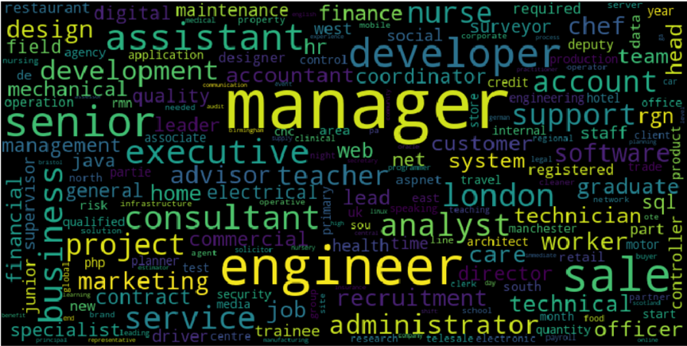
Best Skills To Have! (Job Description)
Top 5 frequent words : Manager, Engineer, Sales, Senior and Developer

Slide 10
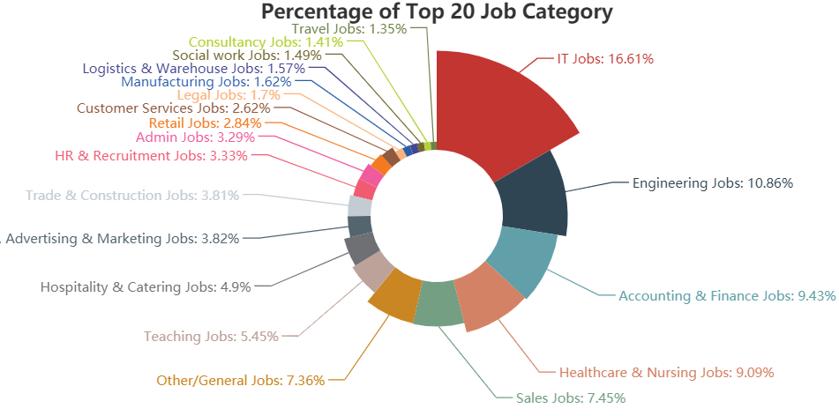
Which Jobs Are The Most Prevalent? (Top 20)

Slide 11
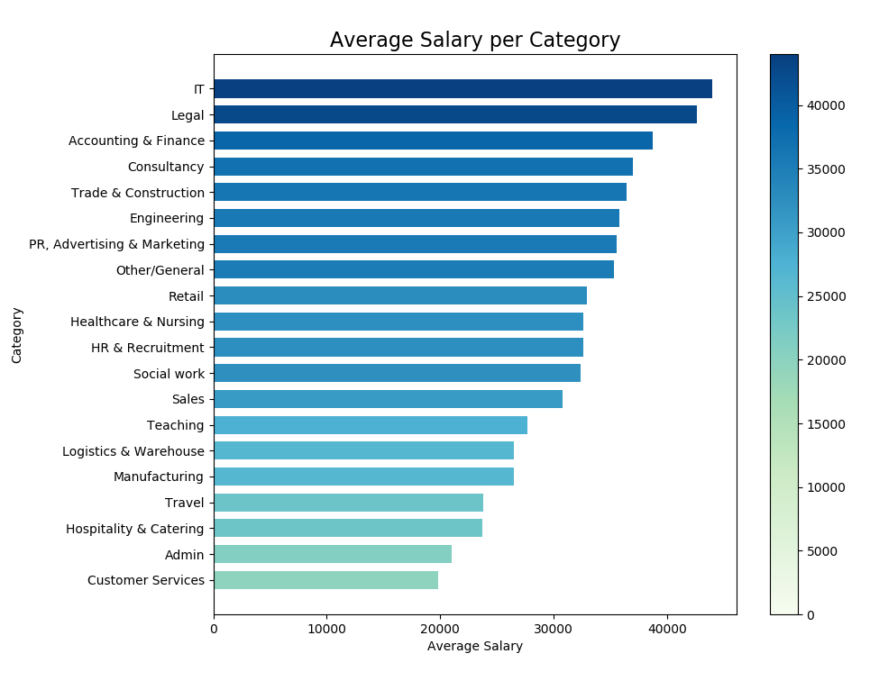
What Jobs Pay The Best? (Top 20 - frequency)
IT, Legal and Finance Jobs
IT Jobs are also the most numerous
Notes:
Top20 - number

Slide 12
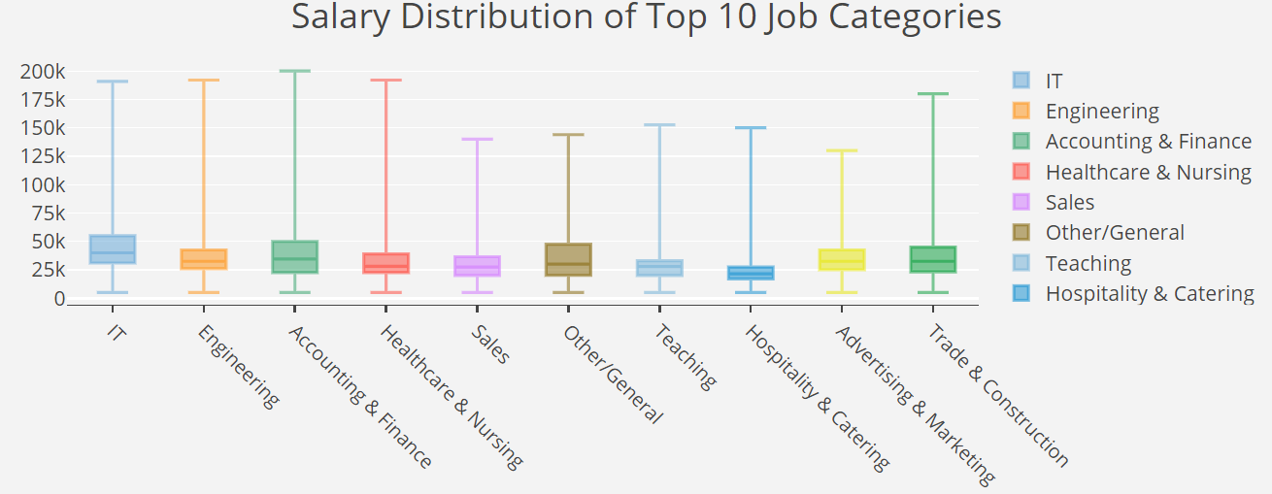
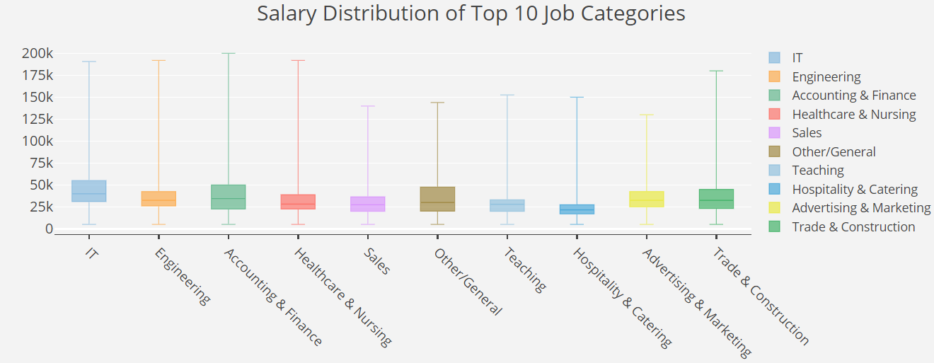
Salary Distribution For Each Job Category (Top 10)
Engineering average is lower than Finance, but lowest salary is higher
Finance ceiling is highest
Notes:
Pay attention to [ Maximum, Minimum, Median, First Quartile, Third Quartile ]
The Professor may ask what they mean.

Slide 13
3
Attributes of Location & Category
Based on Top 3 (IT, Engineering, Finance)

Slide 14
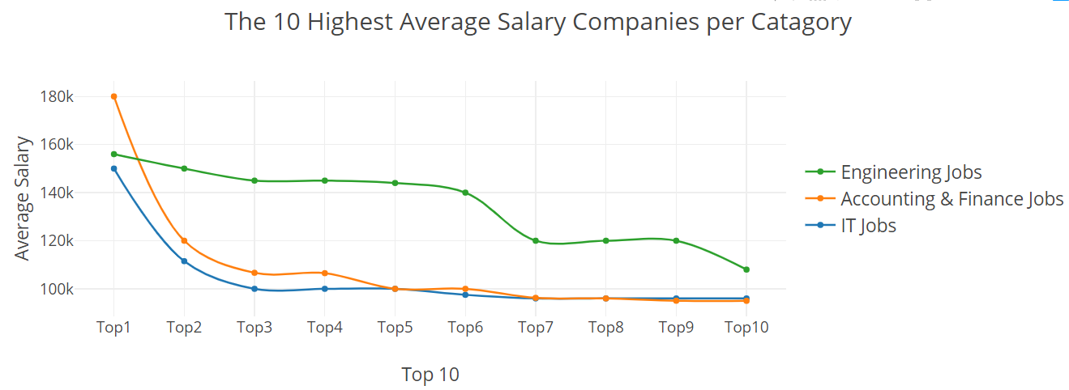
Does It Pay To Work For A Premier Company ?
For IT and finance you want to work at premier companies
For engineering it’s not as important

Slide 15
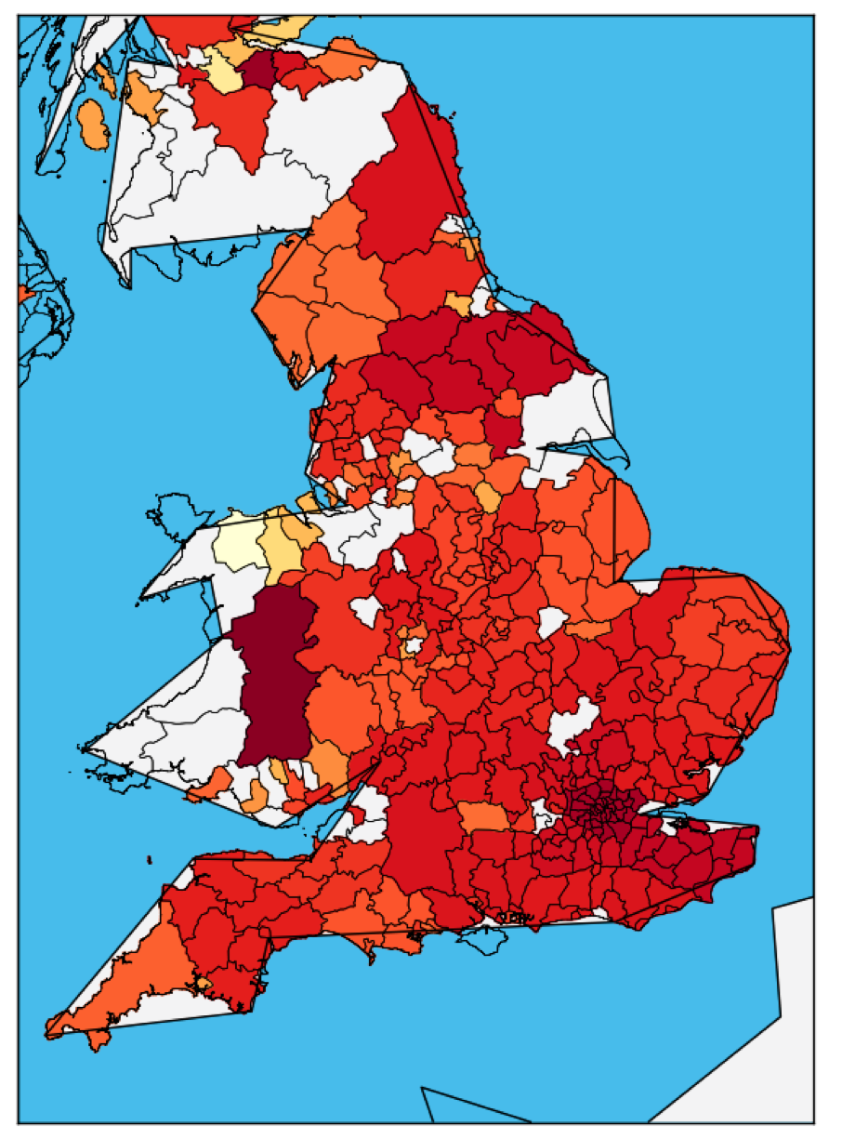
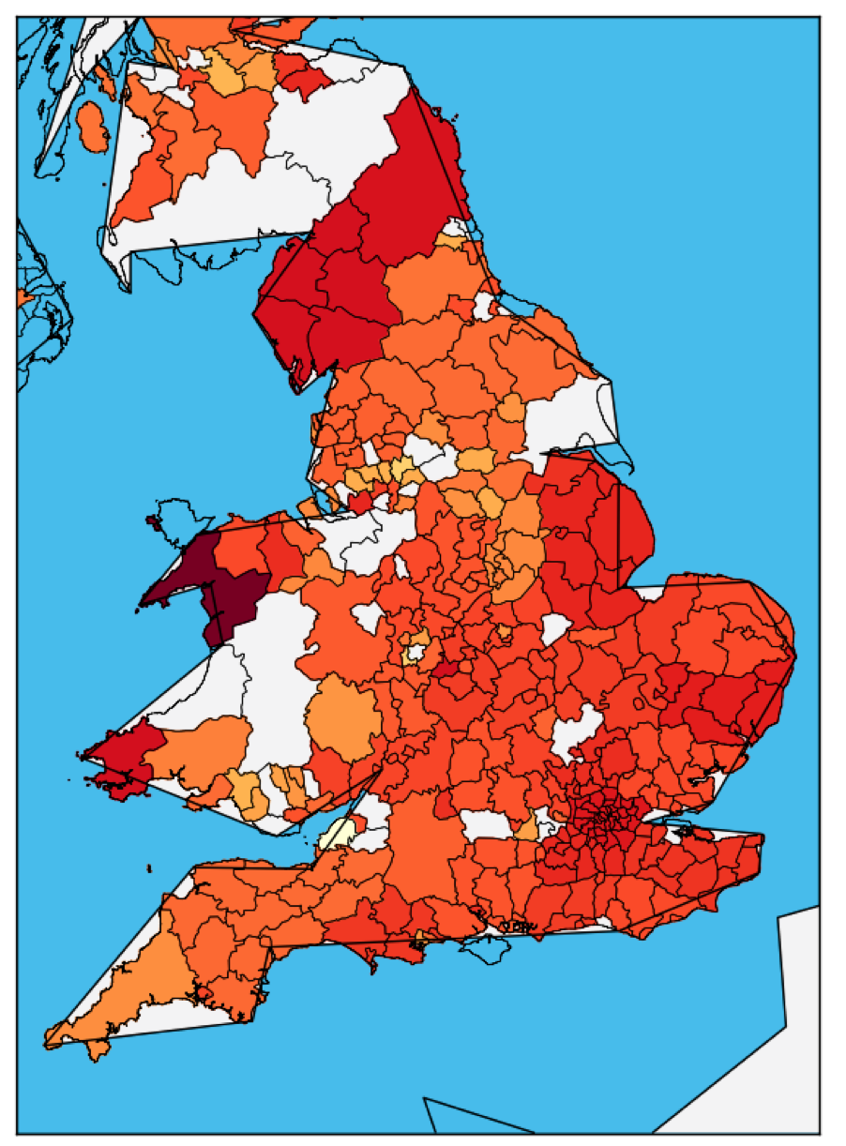
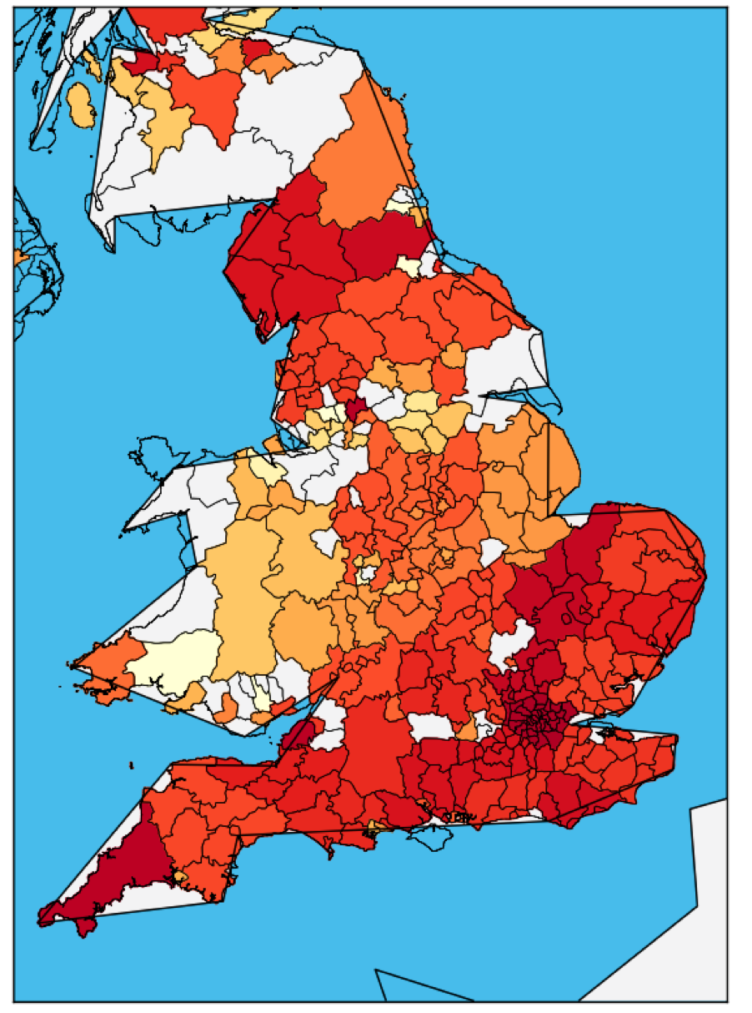
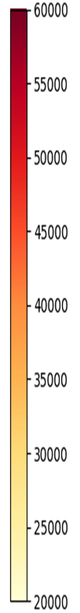
Where To Look For A Specific Job?
IT
Engineering
Finance
Average salary per location
Notes:
(because our dataset does not include all area in UK, so there are some white block)
In order to find the relationship of average salary job, we choose three representative job category which have the largest number of jobs. As we can see from the picture, the average salary of IT jobs and Engineering jobs maintain similar in different. On the other hand, average salary of Accounting & Finance Jobs change changed a lot in different location. Therefore, while seeking IT jobs or Engineering jobs, we can ignore location factor, but while seeking Accounting & Finance Jobs, we should pay more attention to location.

Slide 16
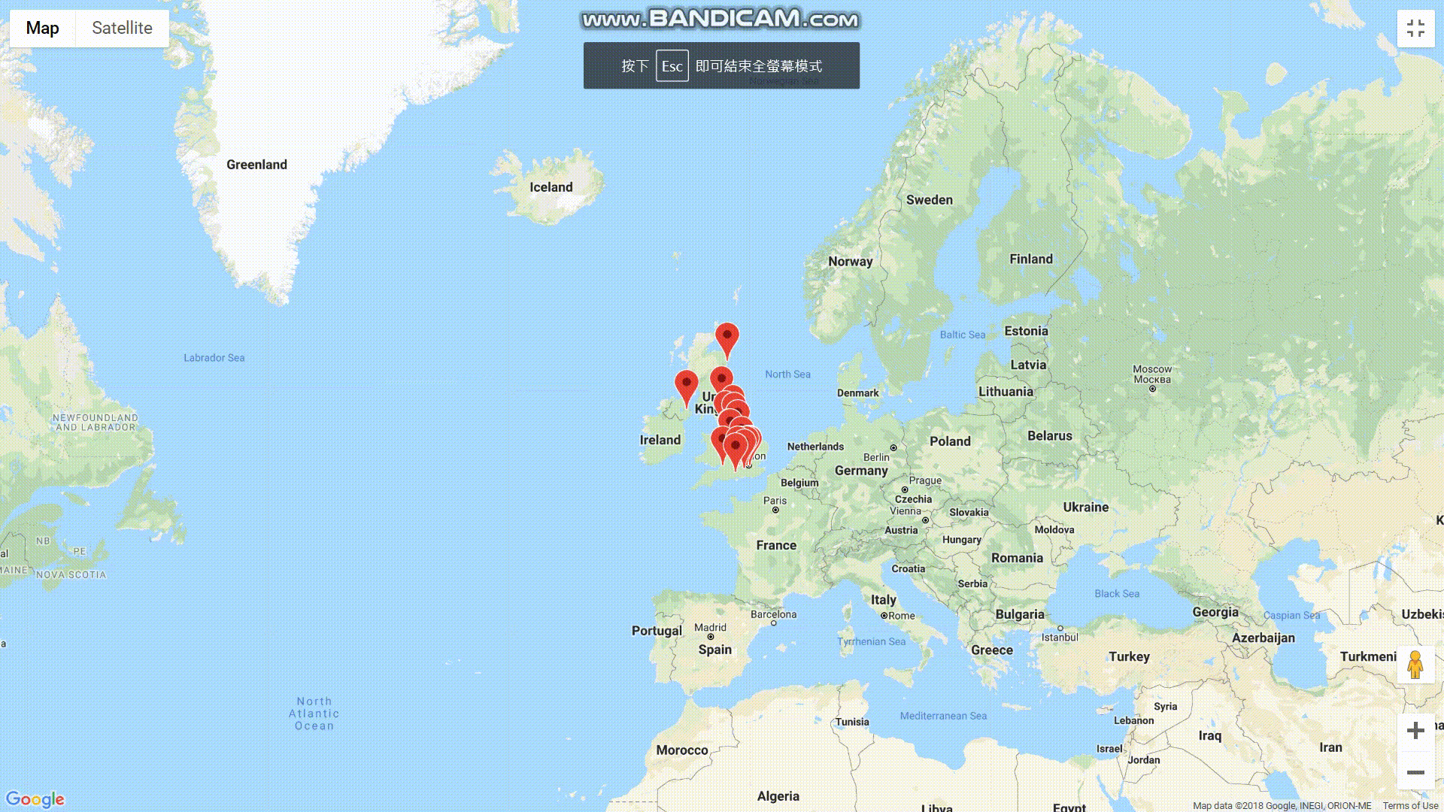
Interactive Map of Job Data (Based on Google Map)
Notes:
(because out dataset does’t include all area in UK, so there are some white block)
The number of jobs varies with location. Similarly, the area near London has a large number of jobs.
During finding job, location is one of the most important factors which we have to consider and the area near London is good choice.
We summarize exact number of above two information of Top 20 location(which have higher frequency in dataset) and generate a dynamic UK map for them.

Slide 17
4
Conclusion
PPT模板下载：www.1ppt.com/moban/ 行业PPT模板：www.1ppt.com/hangye/
节日PPT模板：www.1ppt.com/jieri/ PPT素材下载：www.1ppt.com/sucai/
PPT背景图片：www.1ppt.com/beijing/ PPT图表下载：www.1ppt.com/tubiao/
优秀PPT下载：www.1ppt.com/xiazai/ PPT教程： www.1ppt.com/powerpoint/
Word教程： www.1ppt.com/word/ Excel教程：www.1ppt.com/excel/
资料下载：www.1ppt.com/ziliao/ PPT课件下载：www.1ppt.com/kejian/
范文下载：www.1ppt.com/fanwen/ 试卷下载：www.1ppt.com/shiti/
教案下载：www.1ppt.com/jiaoan/
字体下载：www.1ppt.com/ziti/

Slide 18
Conclusion
37%
Engineering jobs and IT jobs can be found everywhere whereas finance jobs are mostly found in the major cities
17%
IT jobs are both the most frequent category of job and also have the highest average salary
17%
The city of London is the best place to find the highest paying jobs and also has the most job opportunities
17%
“Manager” was the most likely job title that these listing were looking for
Notes:
*Specific number of percentage has to be changed.
17% - IT job numbers / All category job numbers
37% - IT & Engineering & Finance Job Numbers / All category job numbers
17 % - ”Manager” appearance of times
17 % - London Job numbers / All location job numbers

Slide 19
THANK
YOU

Slide 20
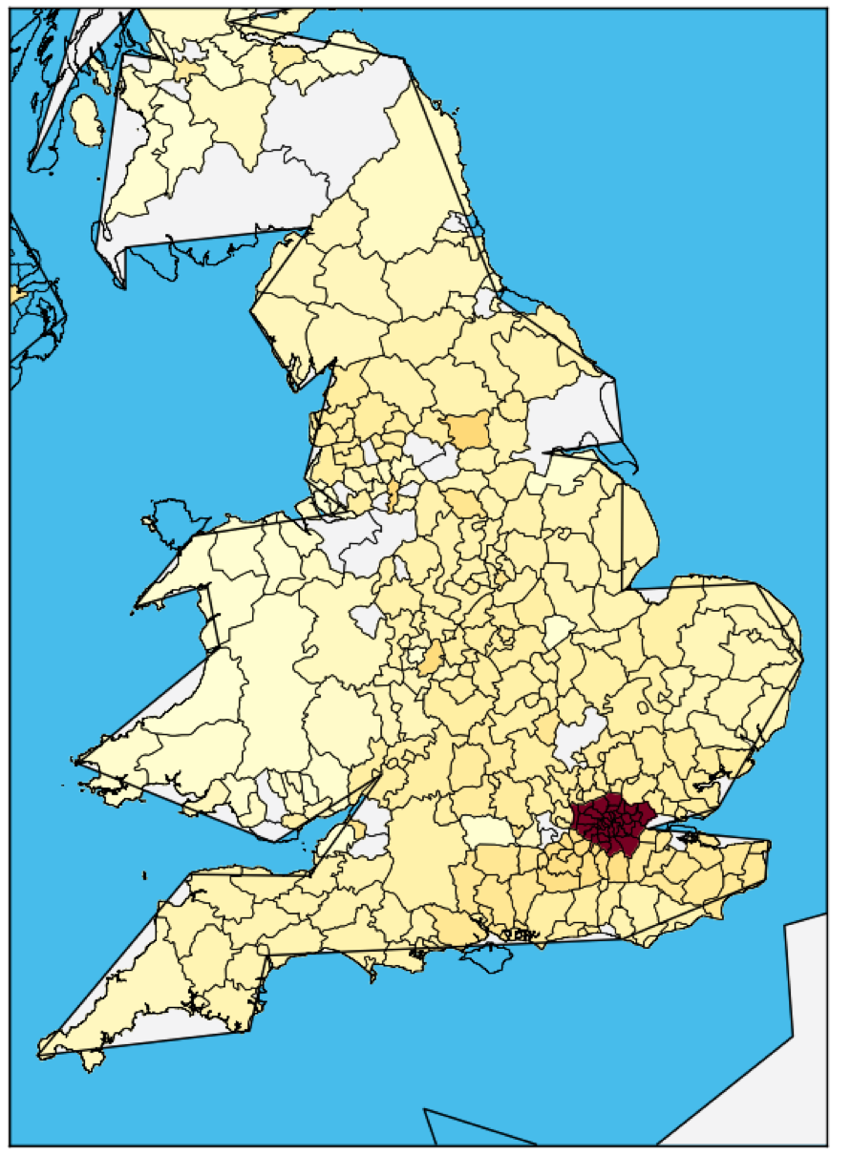
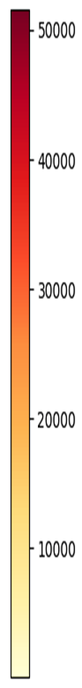
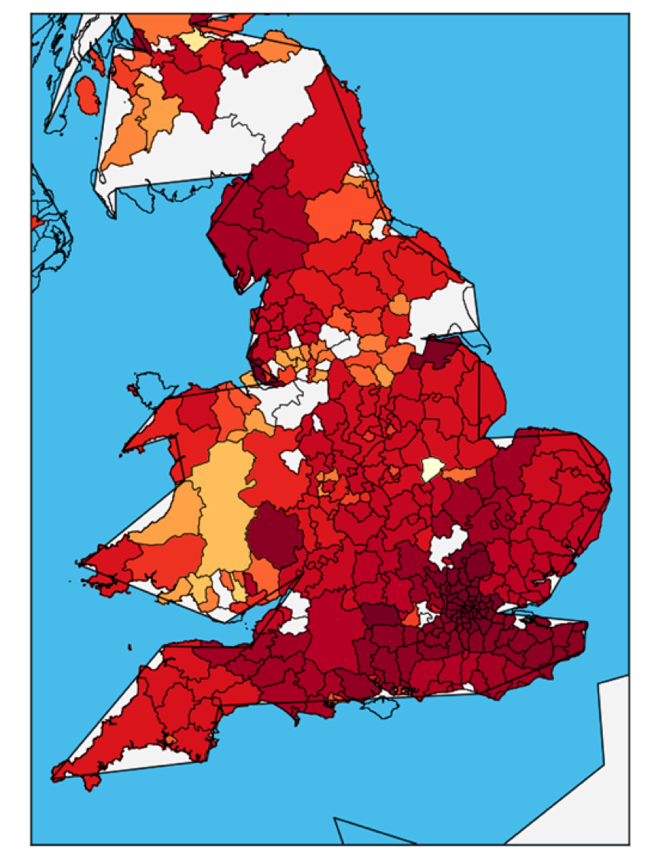
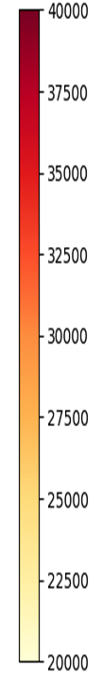
Where To Look For A Job? (Overall)
LONDON
$$$$$$$
Job Numbers per location
Job Average Salary per location
Notes:
(because out dataset does’t include all area in UK, so there are some white block)
The number of jobs varies with location. Similarly, the area near London has a large number of jobs.
During finding job, location is one of the most important factors which we have to consider and the area near London is good choice.
We summarize exact number of above two information of Top 20 location(which have higher frequency in dataset) and generate a dynamic UK map for them.

Slide 21
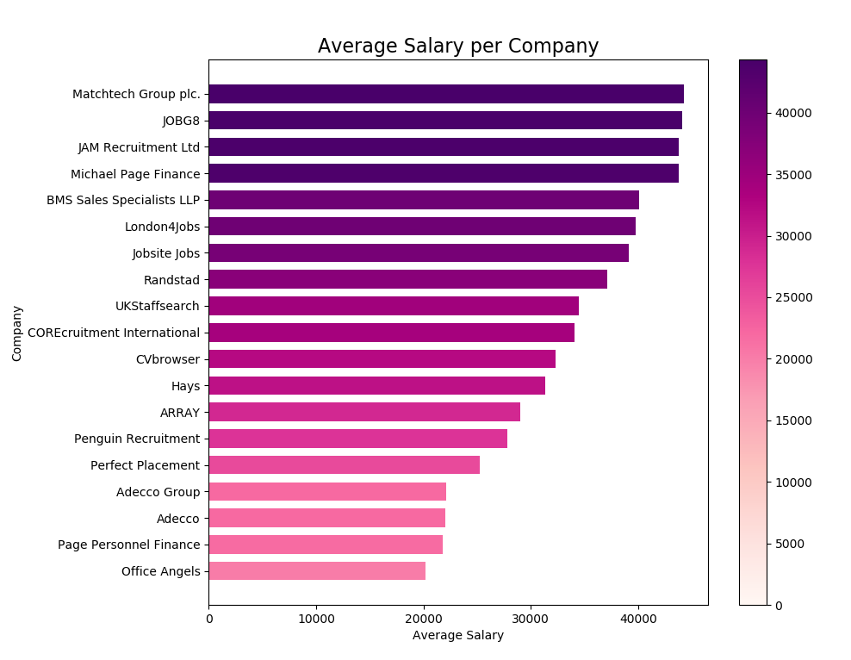
What Companies Pay The Best? (Top 20 - frequency)
Only looked at top 20 companies based on the number of job listing
Mostly job placement companies
Notes:
Top20 - number

